Slide 1
Angular WebApp Security with Cookie SessionId
( Reverse engineering Jhipster Generated Code )
arnaud.nauwynck@gmail.com
this document: https://github.com/Arnaud-Nauwynck/Presentations/Web/
CookieSessionId-Angular-ReverseEngineering-Jhipster

Slide 2
Comparison Only with the JWT Mode
This document focus on comparisons
of the default "JWT" mode "HTTP Session" Mode
For more detailed screenshots => please see document part 1

Slide 3
Step 1: re-generate ANOTHER Jhipster project with same name
# check already install globally
npm install -g generator-jhipster
# create a new empty dir
mkdir demo-sessionAuth
cd demo-sessionAuth
# launch jhipster generator
jhipster

Slide 4
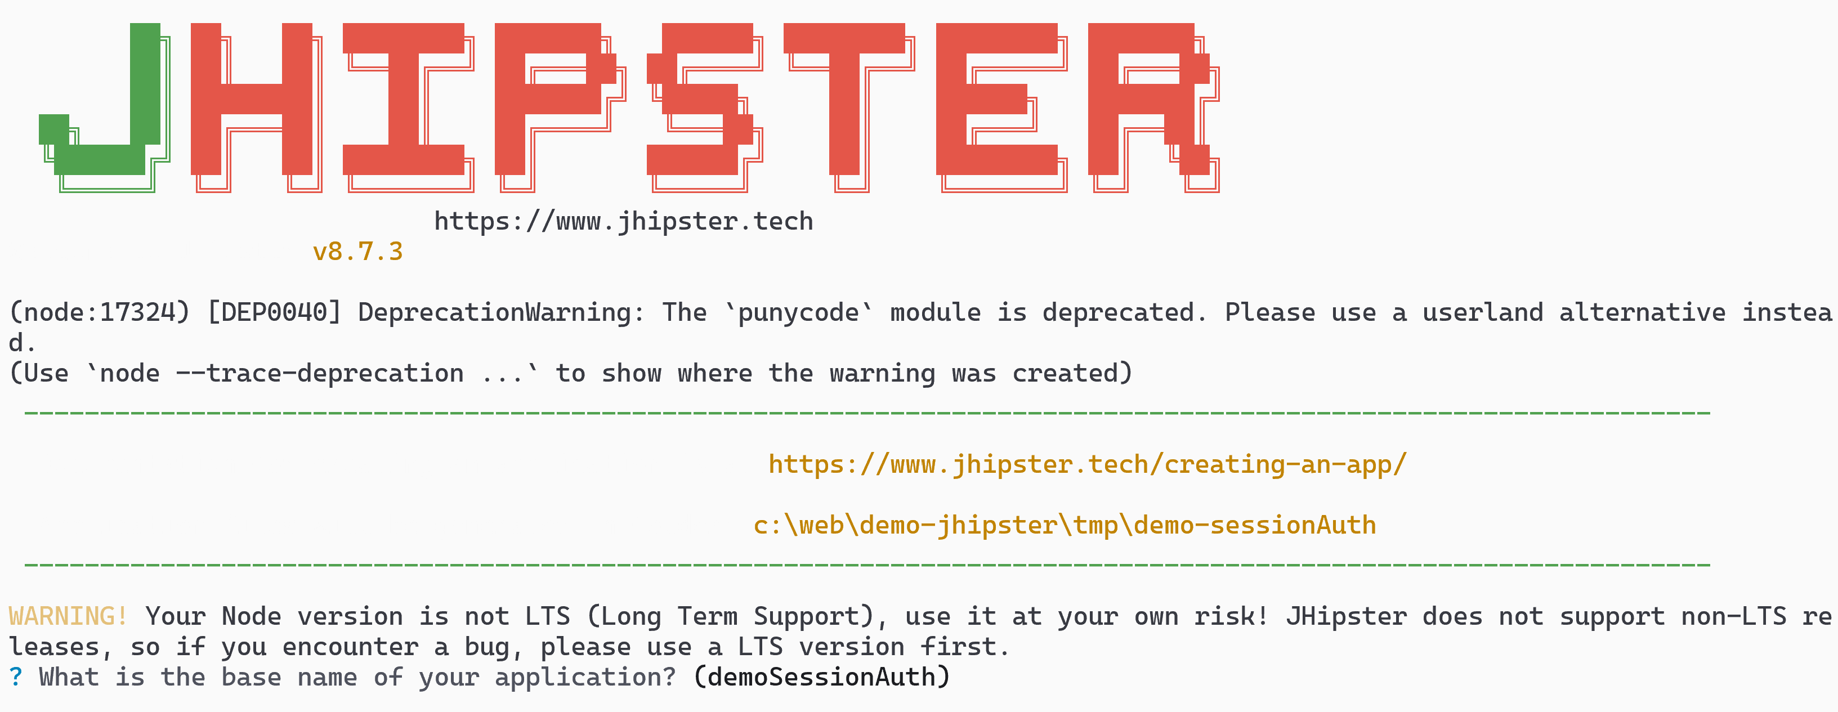
jhipster
when prompted for project name (inferred for current directory name) => change to be same as "demo" project
instead of "demo-sessionAuth"

Slide 5
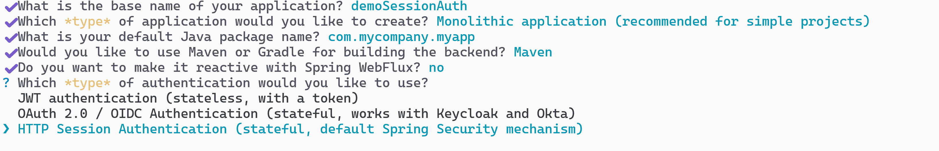
on question "Which type of authentication.. ?" change from default choice #1 to choice #3: HTTP Session Authentication

Slide 6
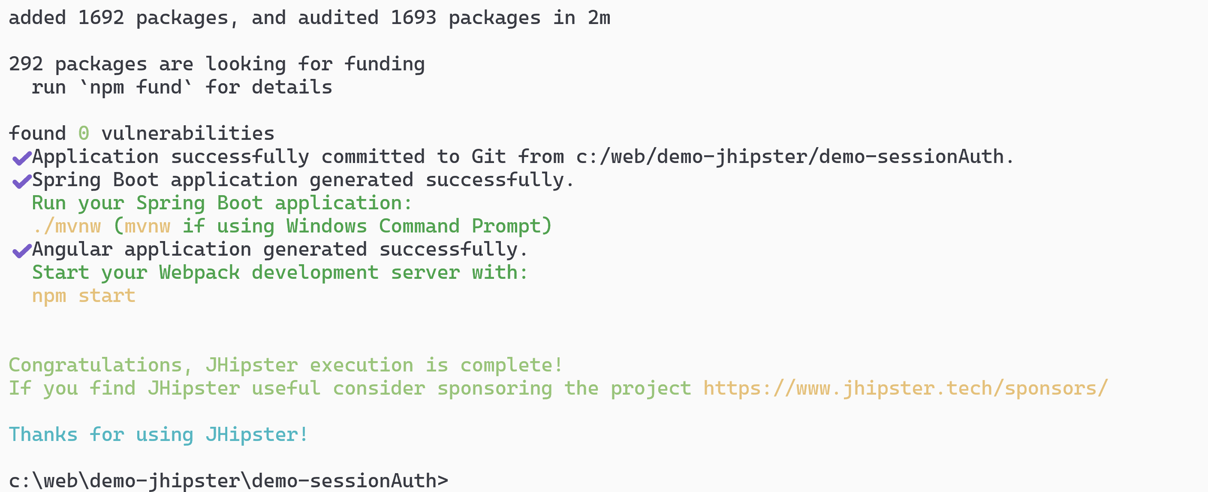
... Wait few minutes

Slide 7
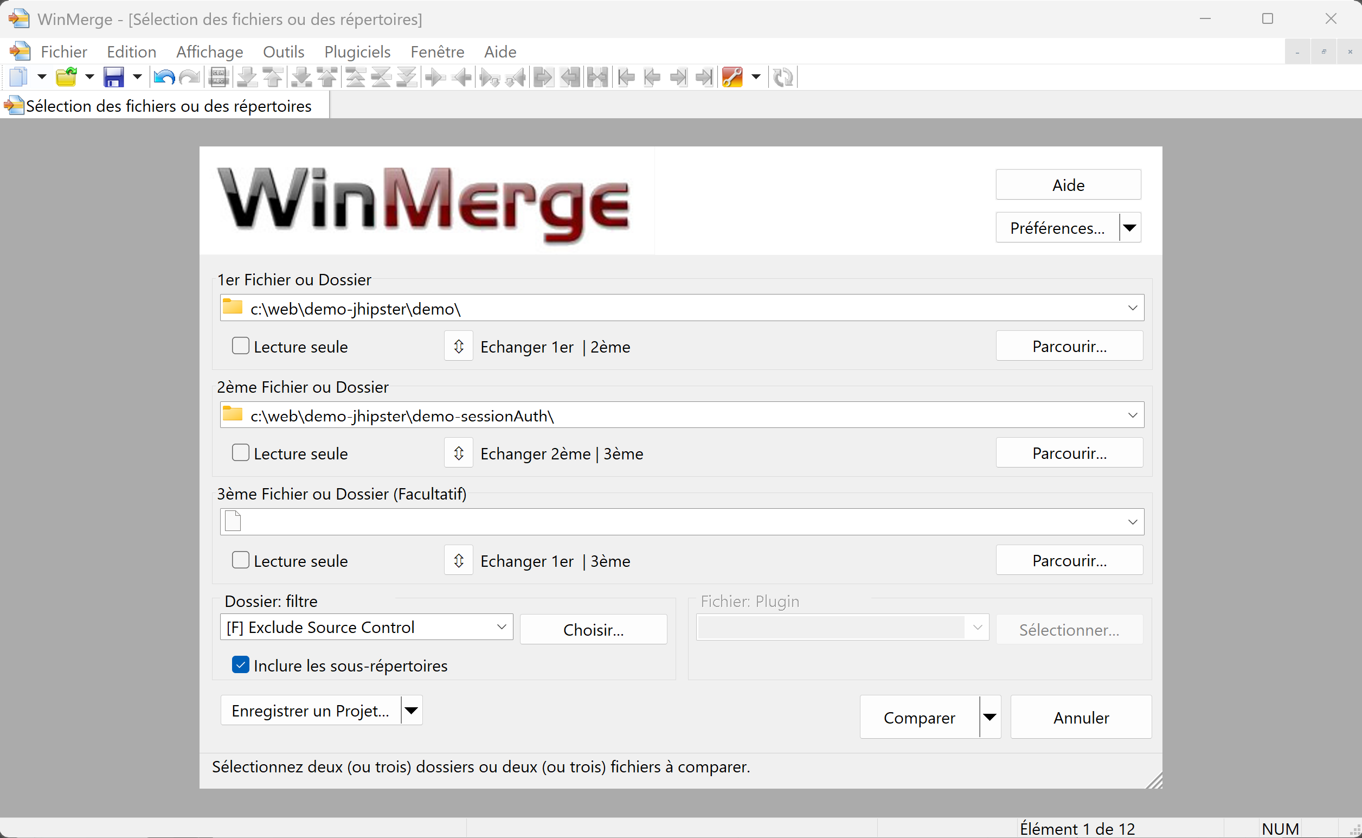
Comparing (WinMerge) Generated Apps JWT <-> HTTP Session

Slide 8
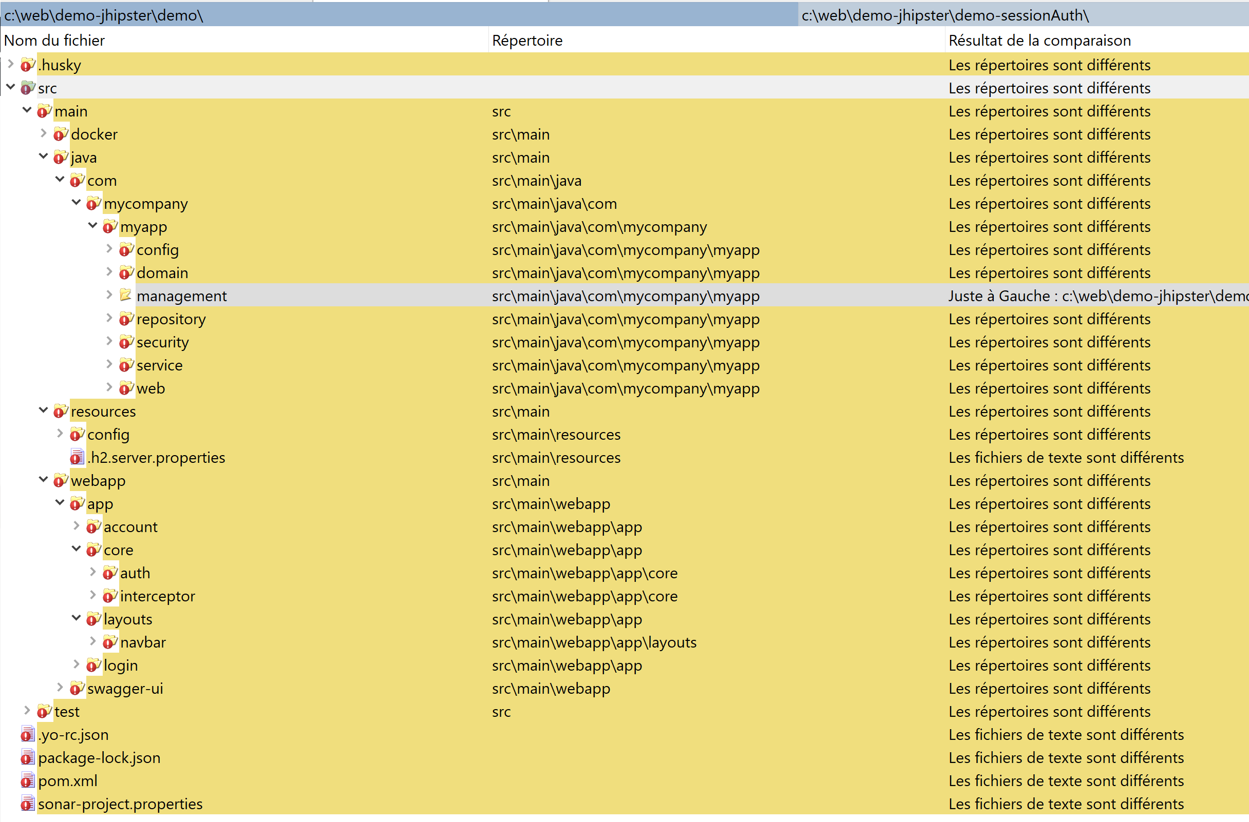
Differences JWT <-> HTTP Session

Slide 9
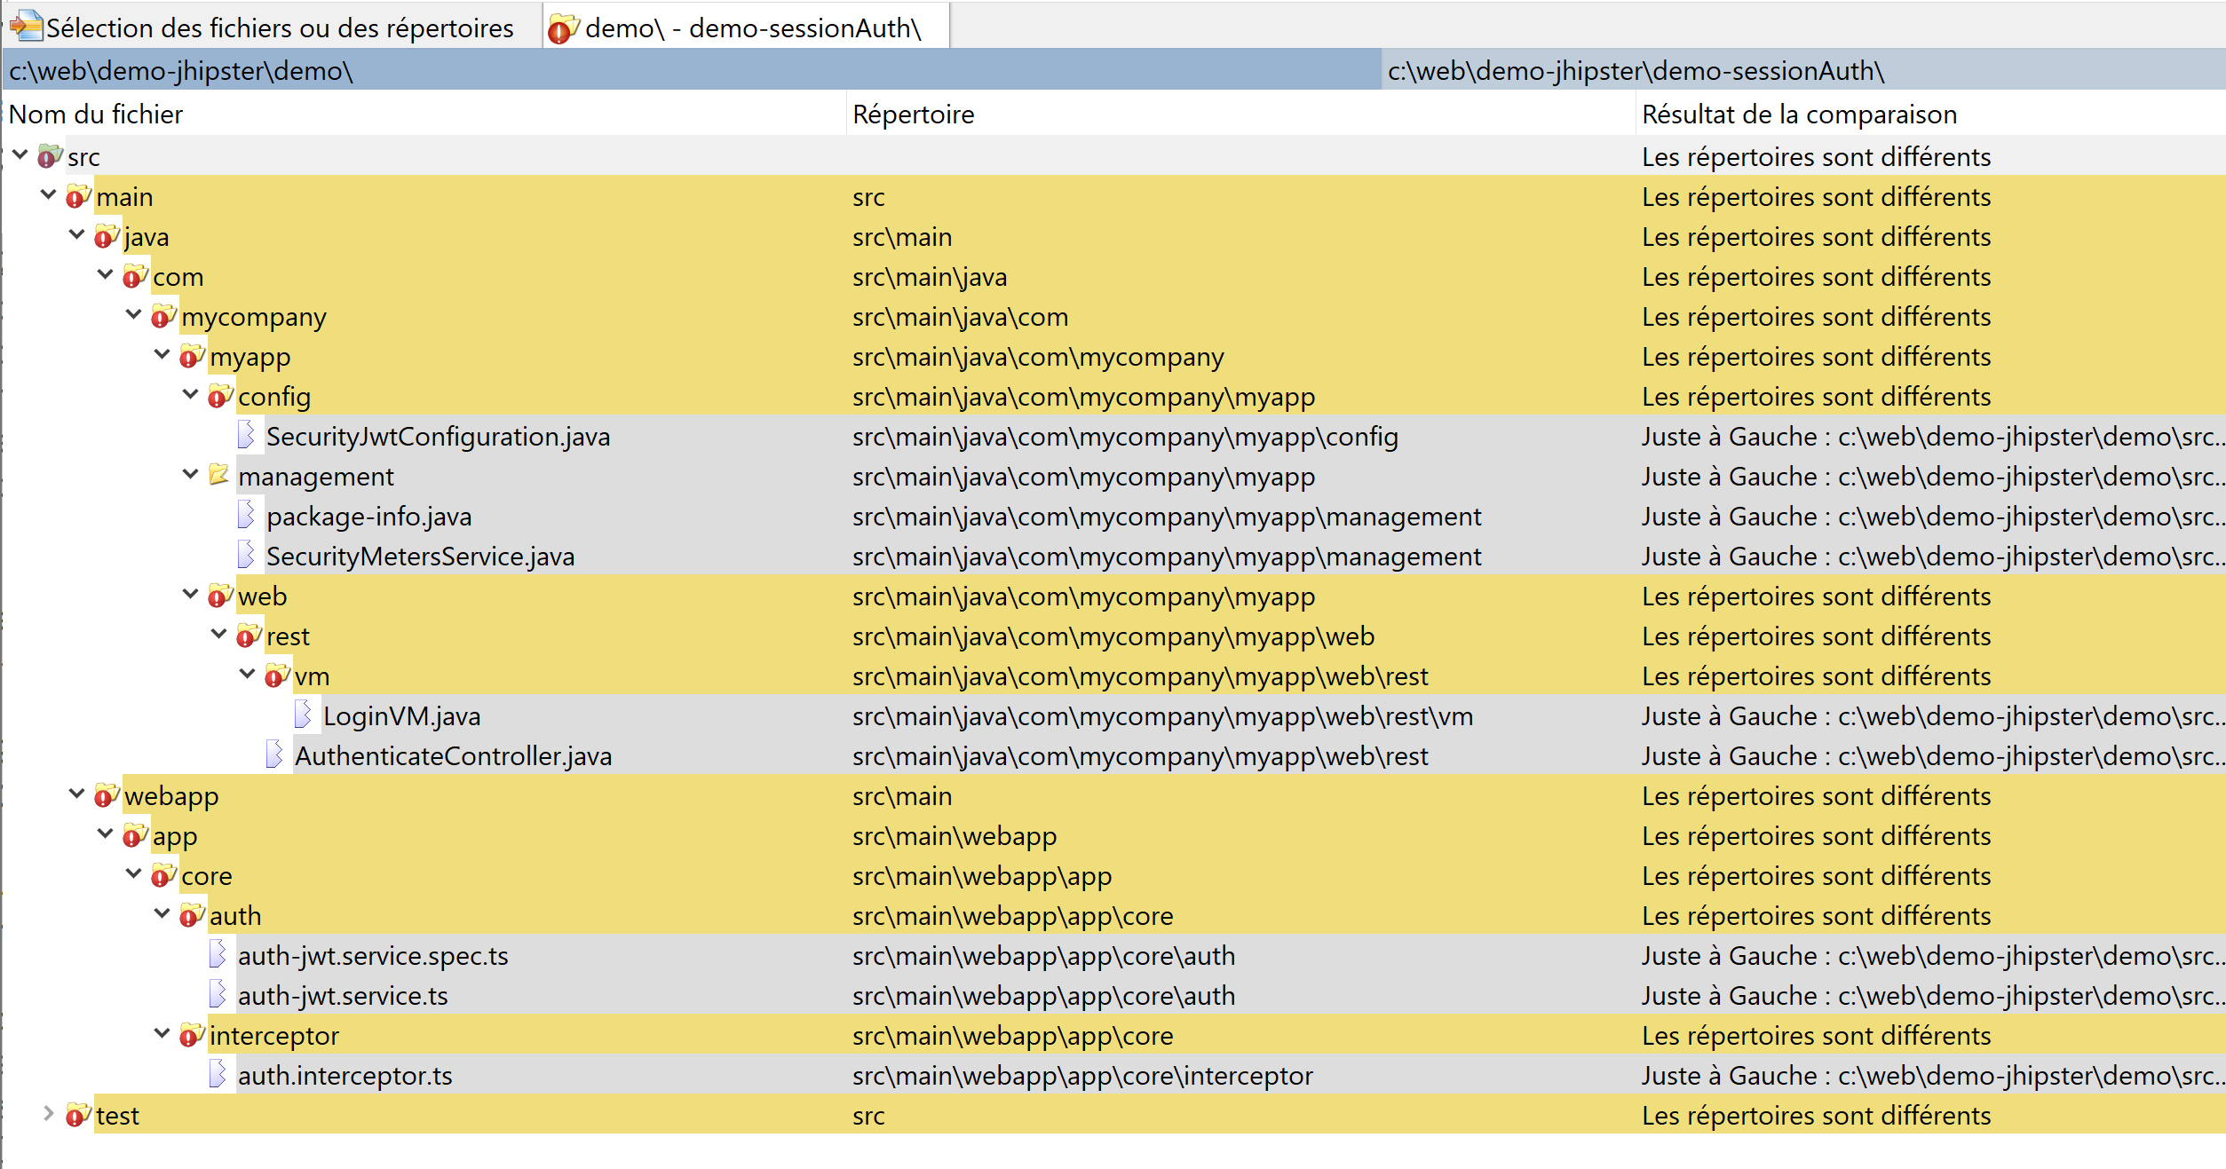
Files Only in "JWT" mode

Slide 10
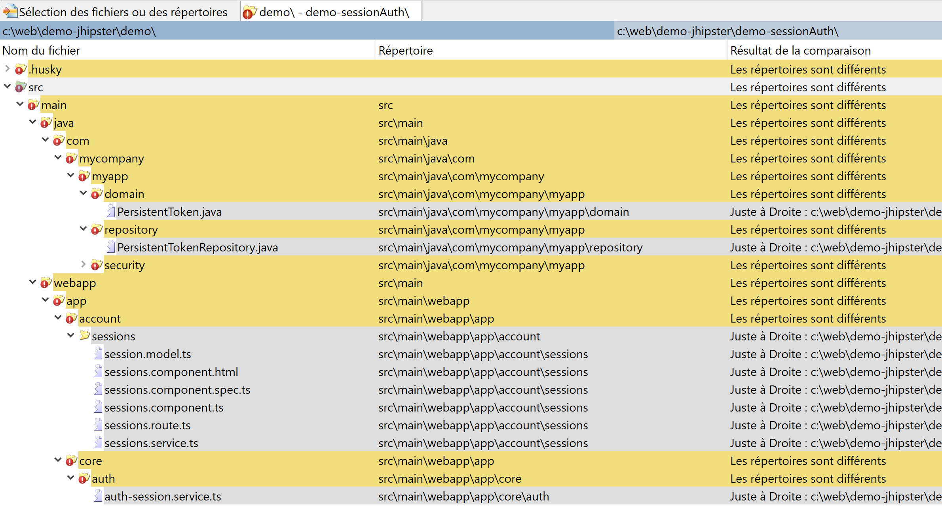
Files Only in "Http Session" Mode

Slide 11
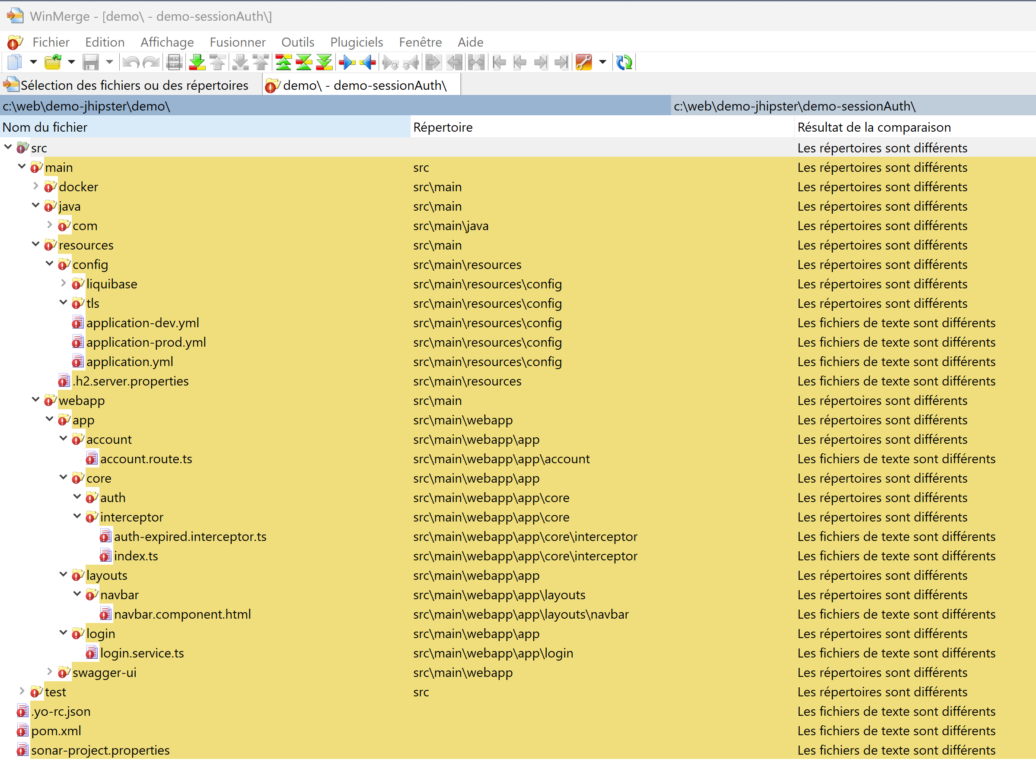
Different Files (maybe not for auth mode)

Slide 12
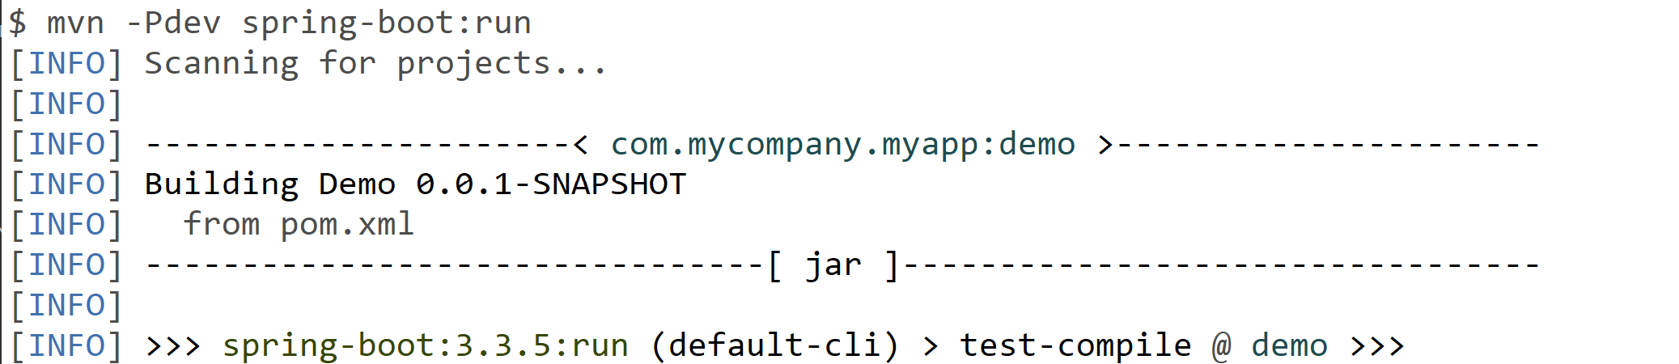
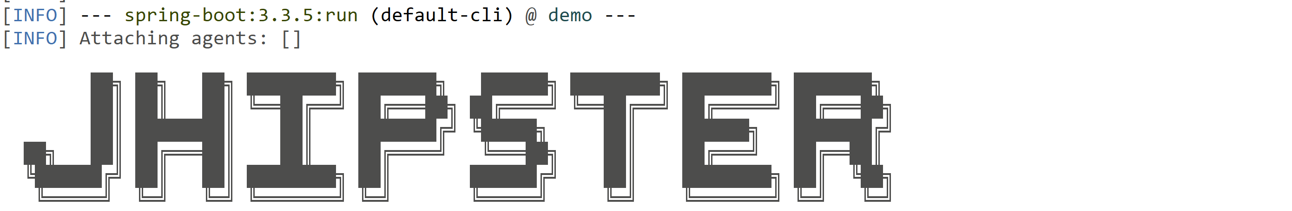
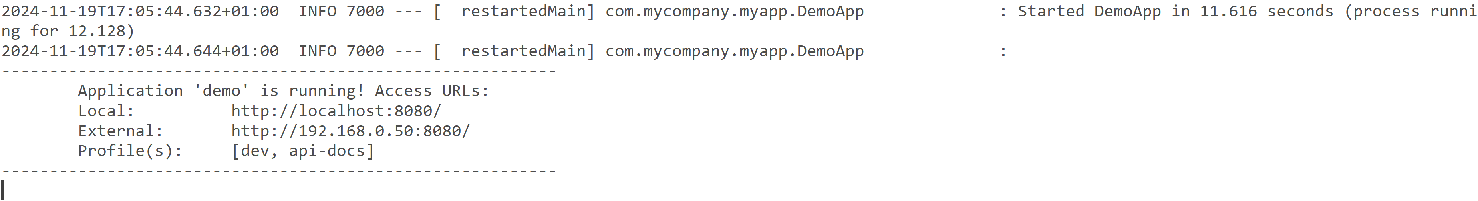
Launching Backend: mvn -Pdev spring-boot:run

Slide 13
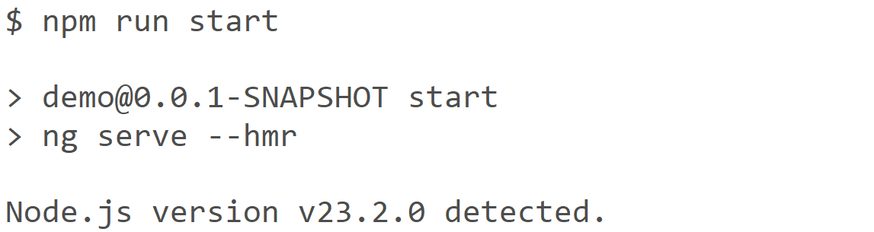
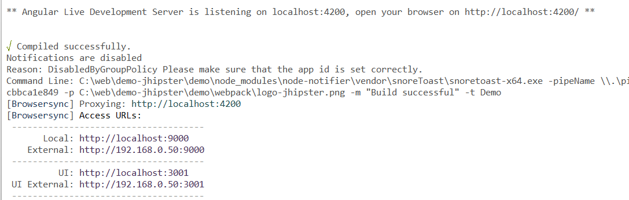
Launching Frontend: npm run start (= ng serve)

Slide 14
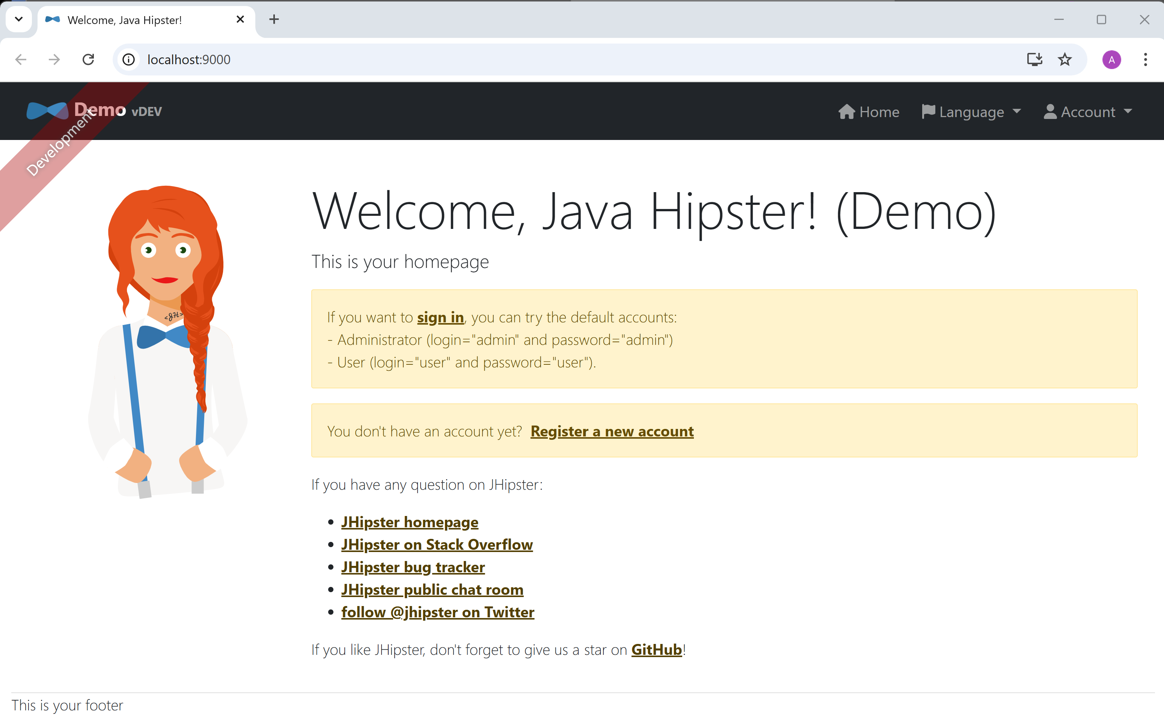
Home page - not logged-in

Slide 15
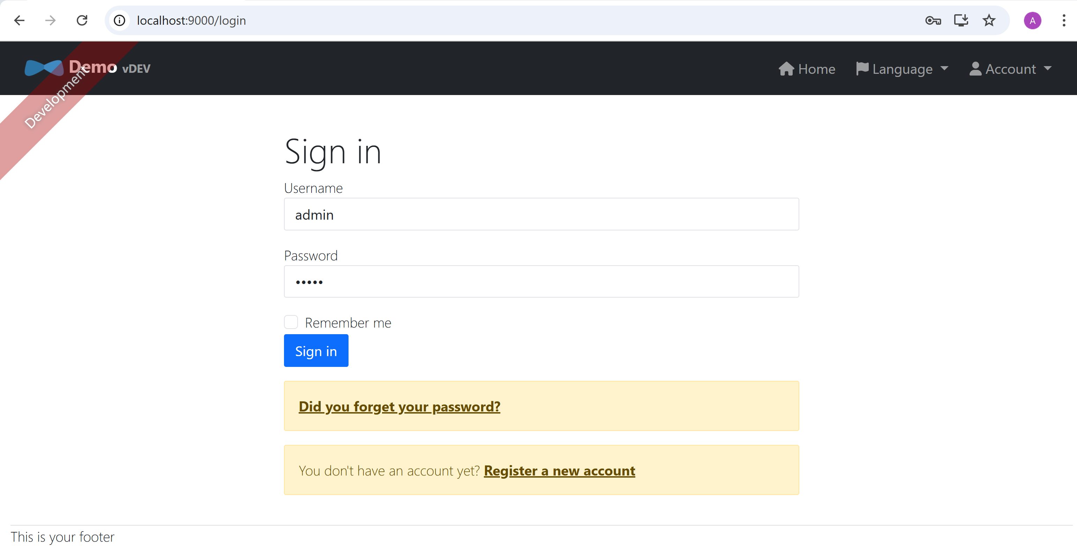
Click sign-in => /login page

Slide 16
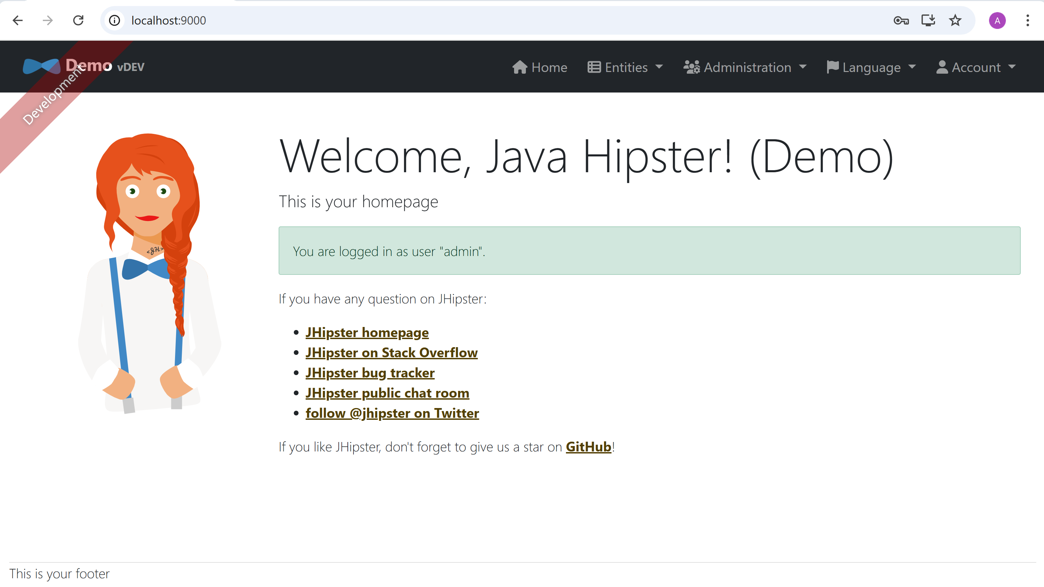
Home Page after logged-in

Slide 17
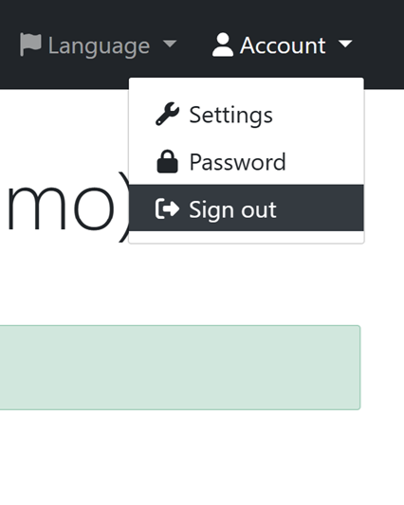
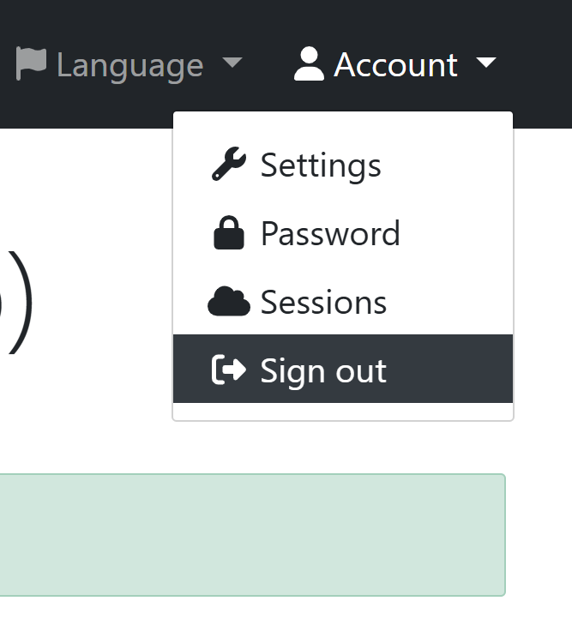
Different Menu for Account Sub Menu Item "Sessions"
"JWT" Mode
"Http Session" Mode

Slide 18
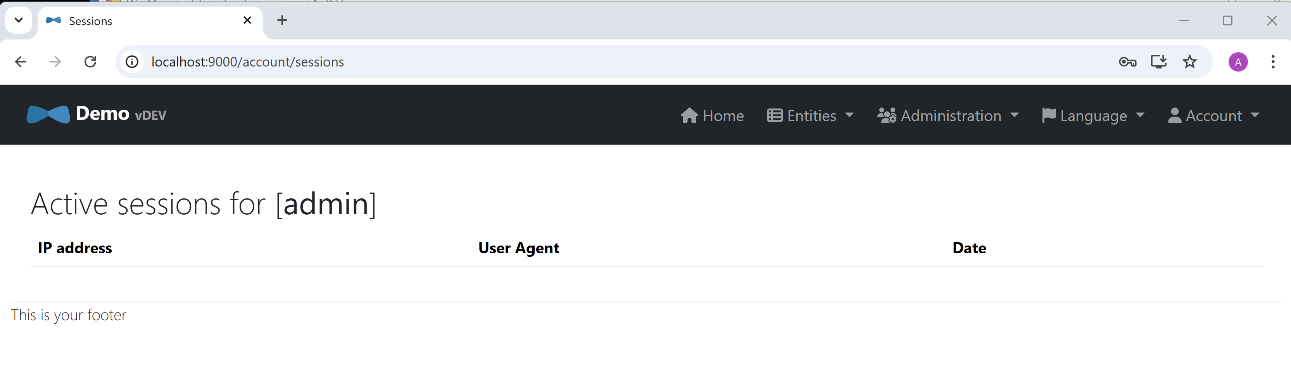
Sessions View for Current User

Slide 19
Debuging Security from "Http" viewpoint

Slide 20
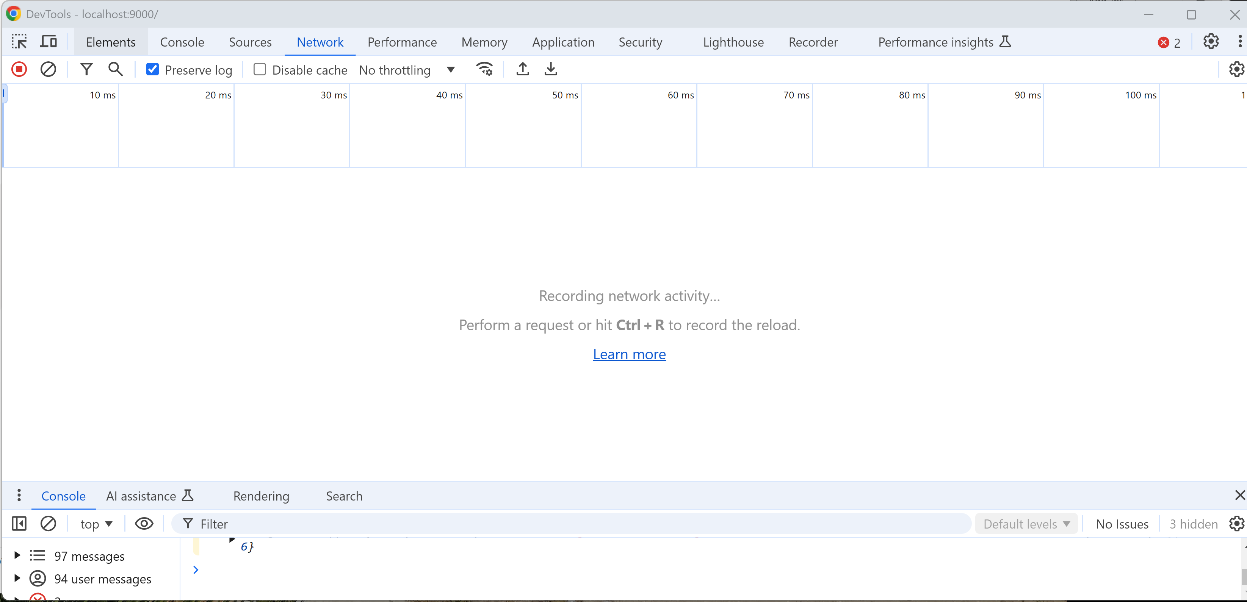
Chrome Dev Tools > Network

Slide 21
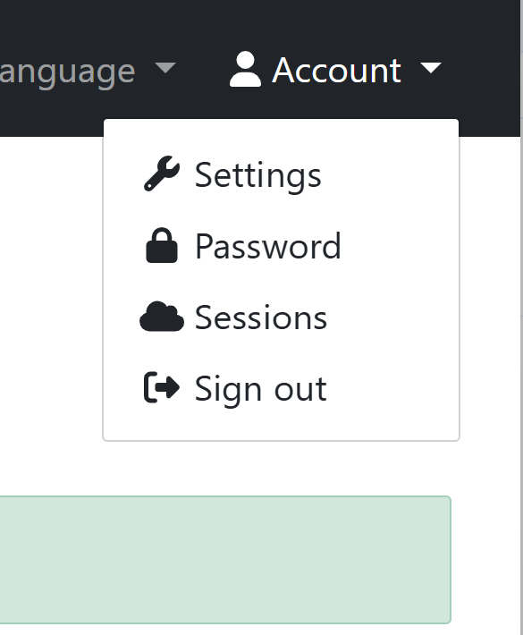
Sign Out => 2 Http calls (was 0 for JWT mode)

Slide 22
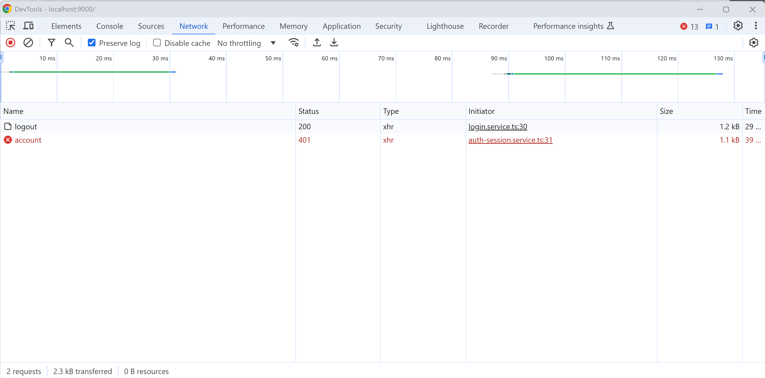
2 Http Requests "/api/logout", then refresh "/api/account"

Slide 23
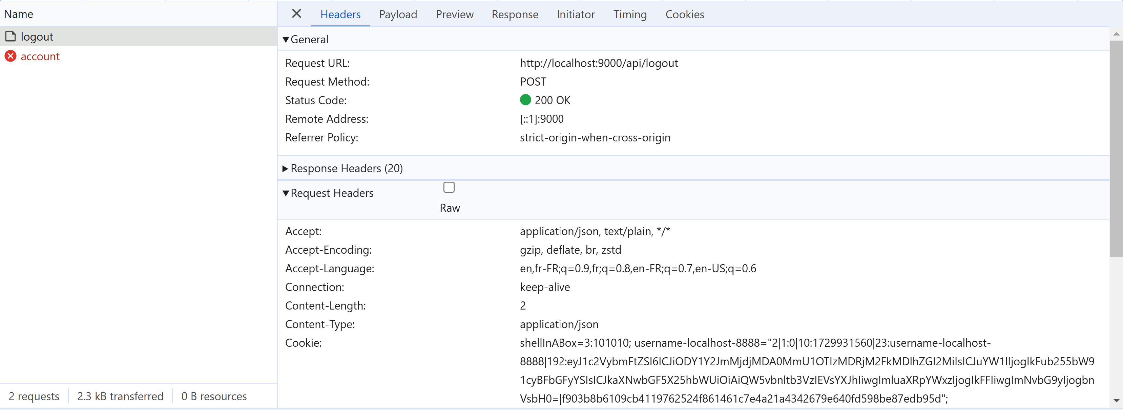
Http POST /api/logout

Slide 24
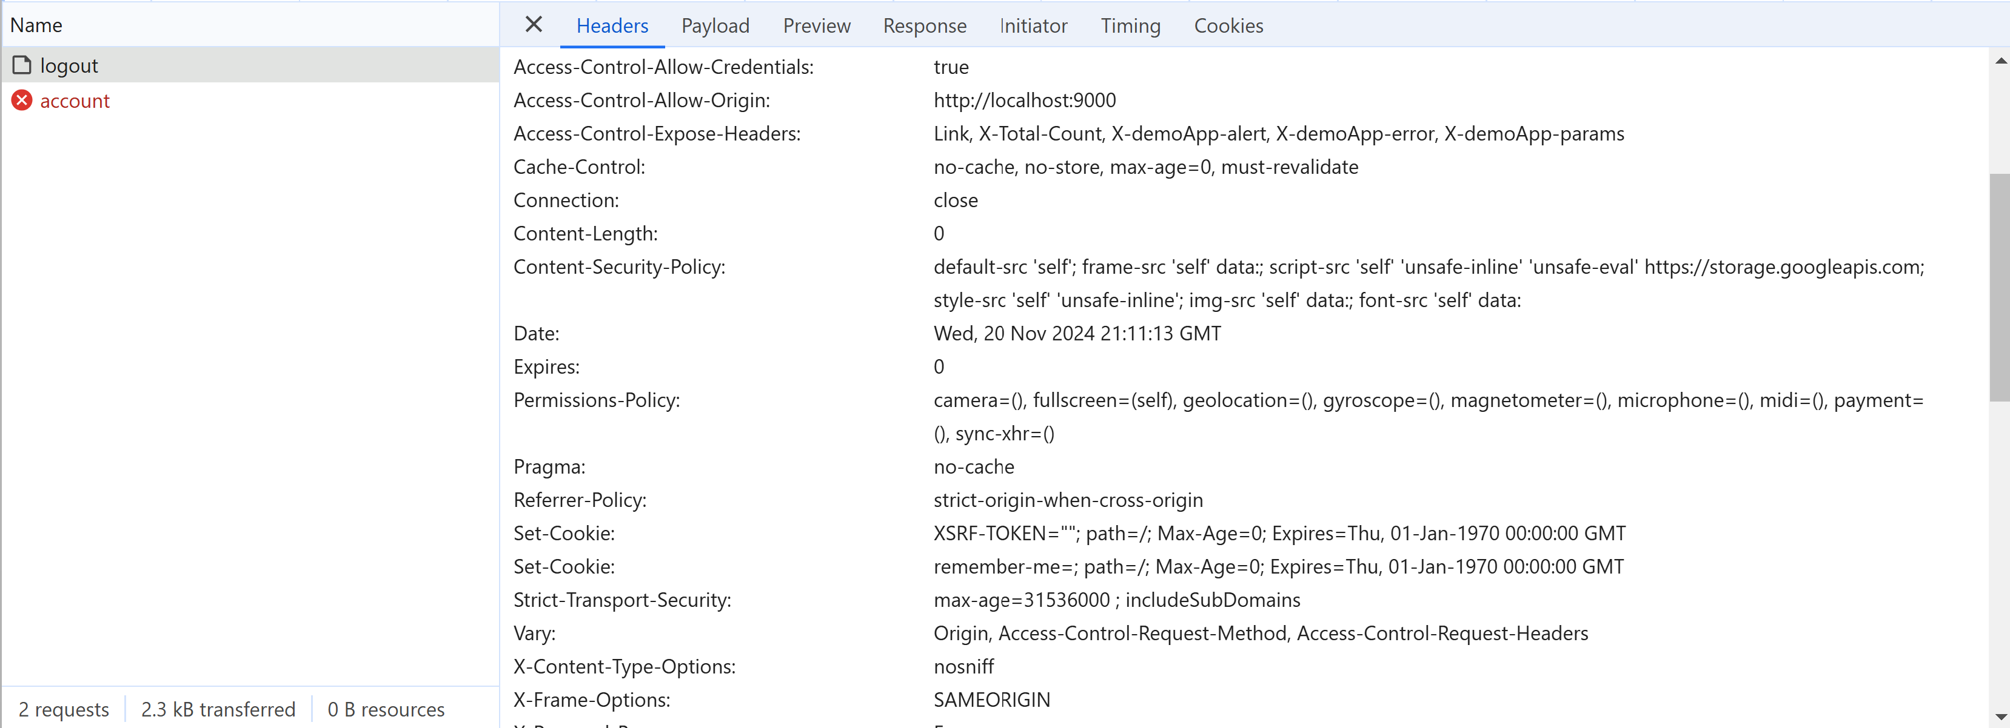
Http POST /api/logout => response Headers : 2 x Set-Cookie: ... to cleanup

Slide 25
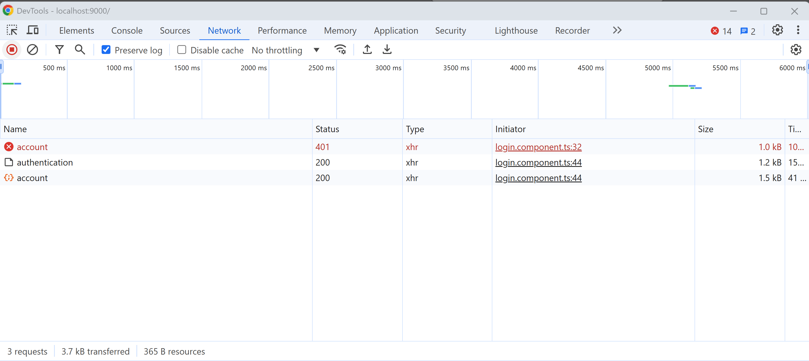
Sign-in => 3 Http Requests

Slide 26
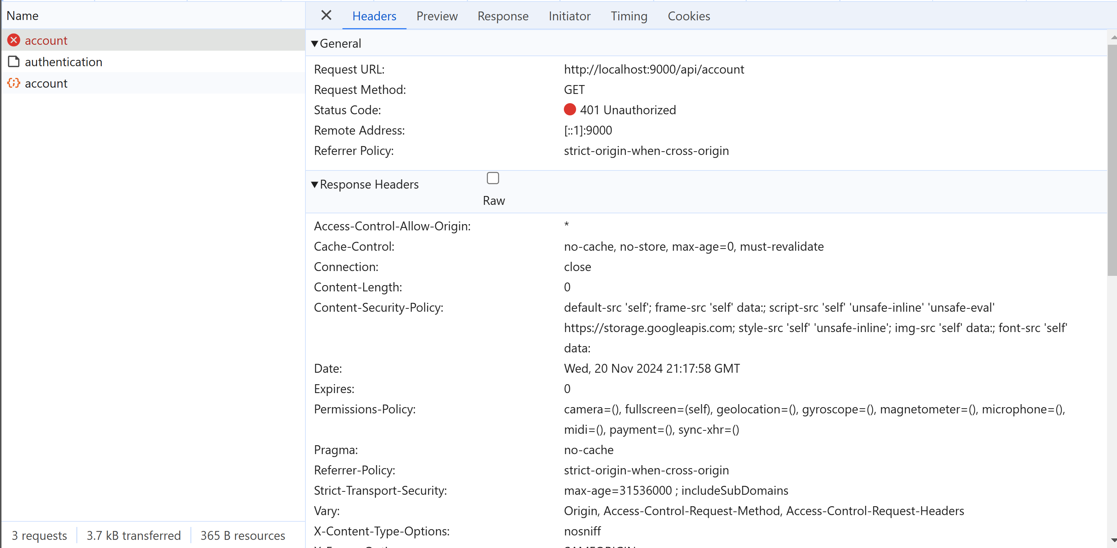
Request [1/3]: Http GET /api/account no auth Header => 401 Unauthorized
MISSING Header "Cookie"= "...; JSESSIONID=..." or Header "Authorization" => FAILING with 401

Slide 27
Request [1/3] http GET /api/account
"JWT" Mode
"Http Session" Mode
IDEM as in JWT Mode

Slide 28
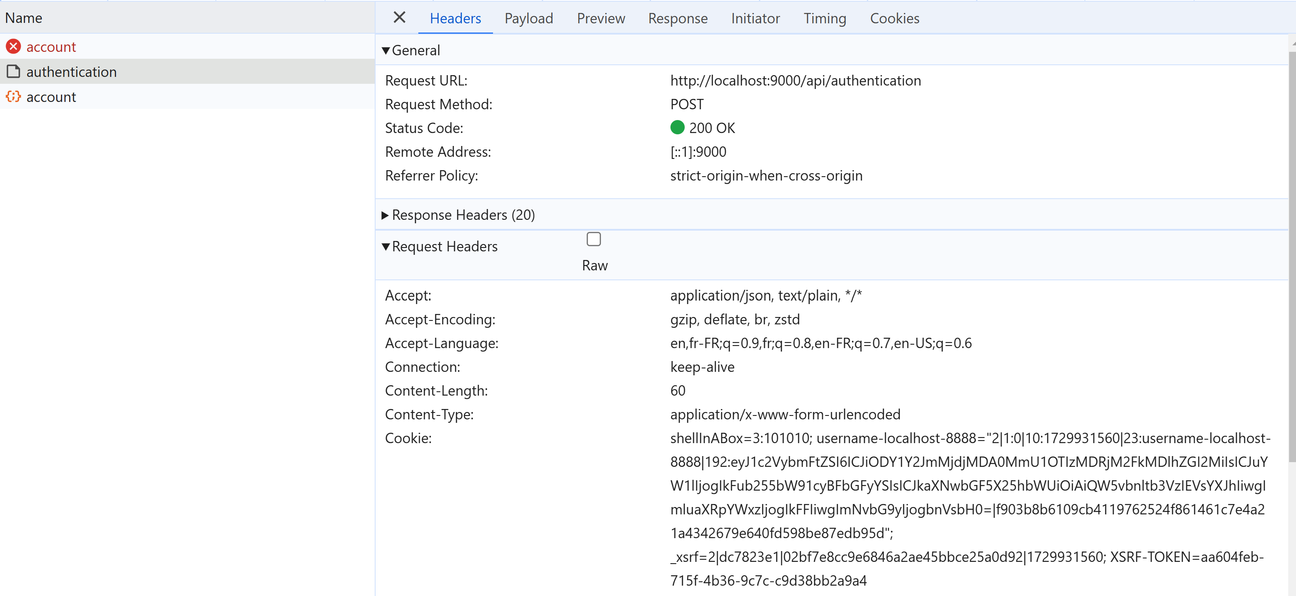
Request [2/3]: Http POST /api/authenticate content-Type: x-www-form-urlencoded

Slide 29
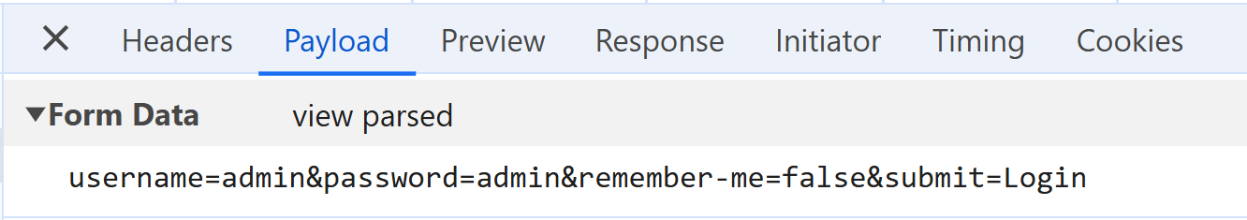
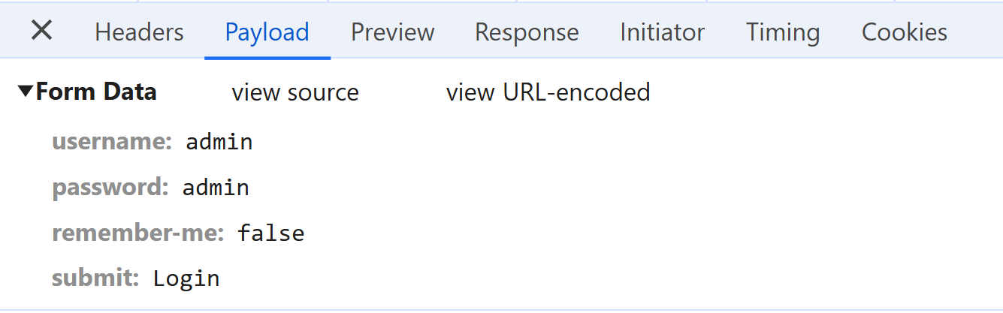
Request [2/3] Payload : username & password

Slide 30
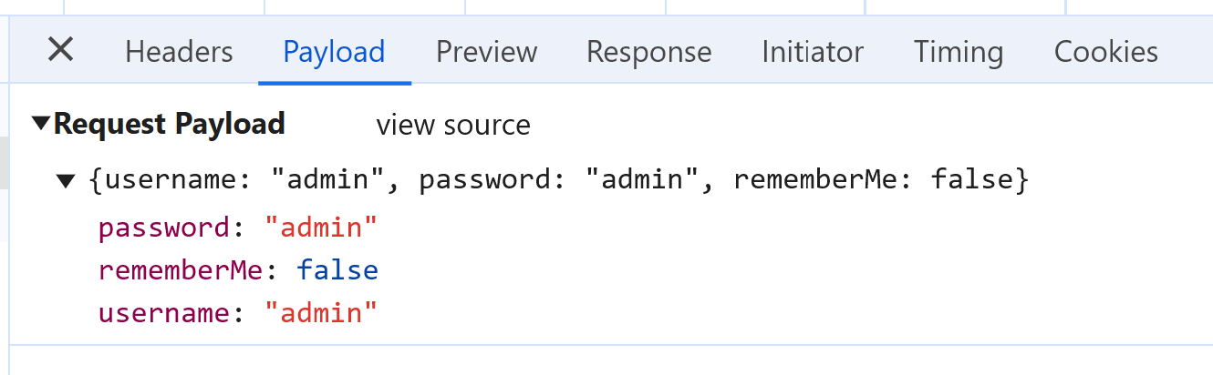
Request [2/3] different (but equivalent) to JWT Mode
"JWT" Mode
"Http Session" Mode
Payload Request Body was in JSON
Payload Request in "URL-encoded"

Slide 31
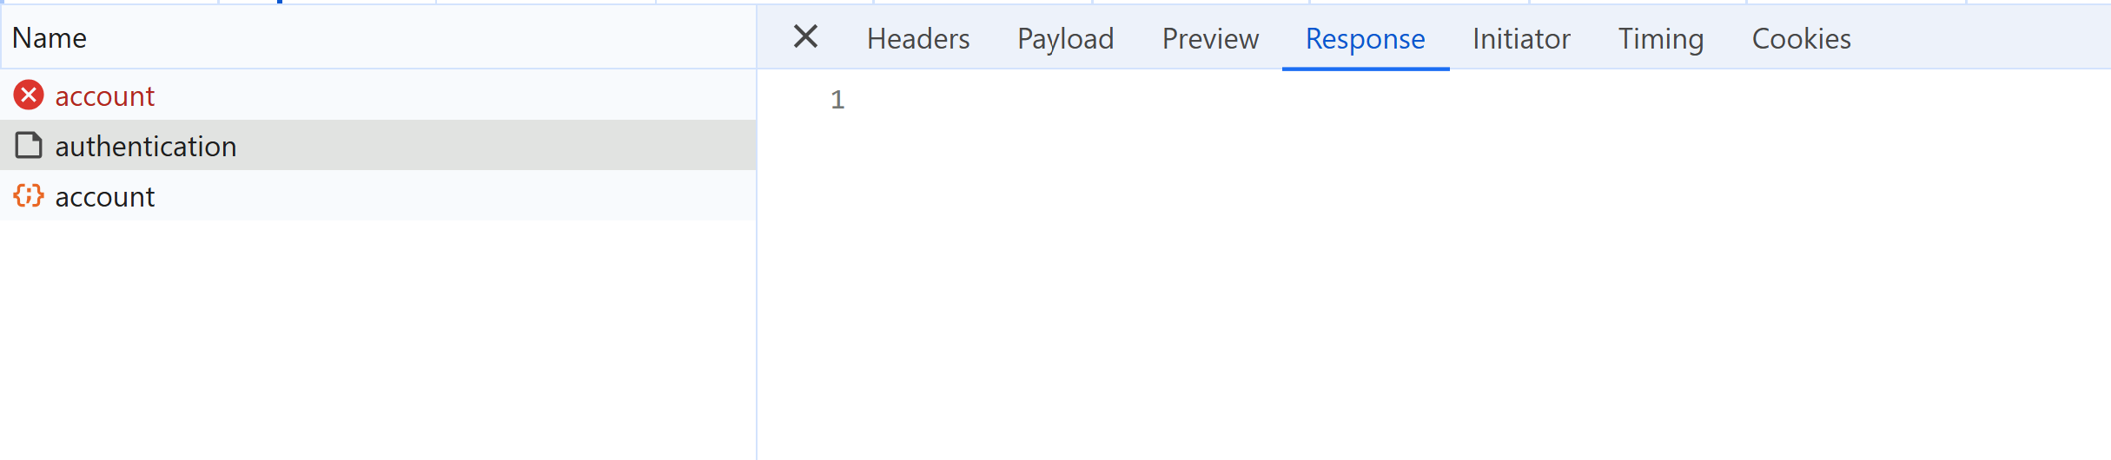
Request [2/3] Response Body : EMPTY !

Slide 32
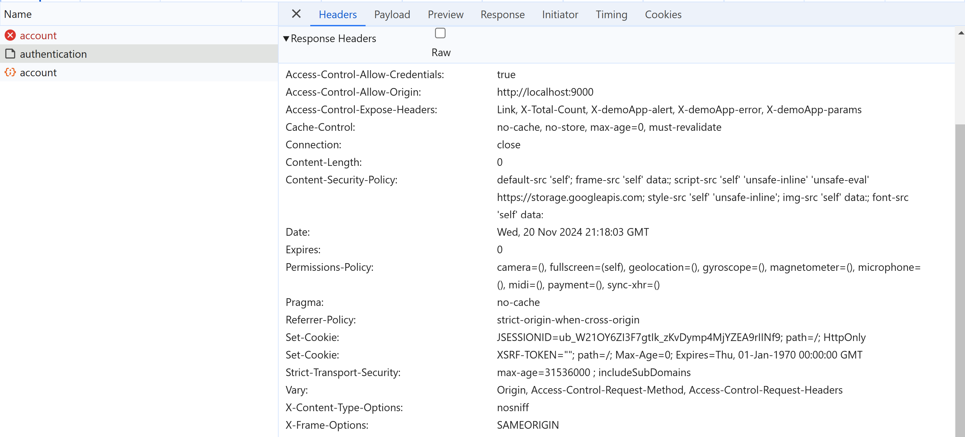
Request [2/3] : Response Header Set-Cookie: "JSESSIONID=xxxx"

Slide 33
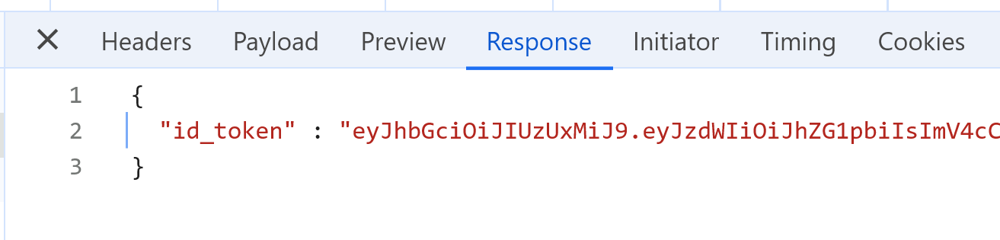
Request [2/3] Difference with JWT Mode
"JWT" Mode
"Http Session" Mode
Response Body was in JSON,
containing the JWT Token
Response Body is EMPTY
the real response is in "SET-COOKIE" Header
to set "JSESSIONID=xxx"
the JSESSIONID is the secret

Slide 34
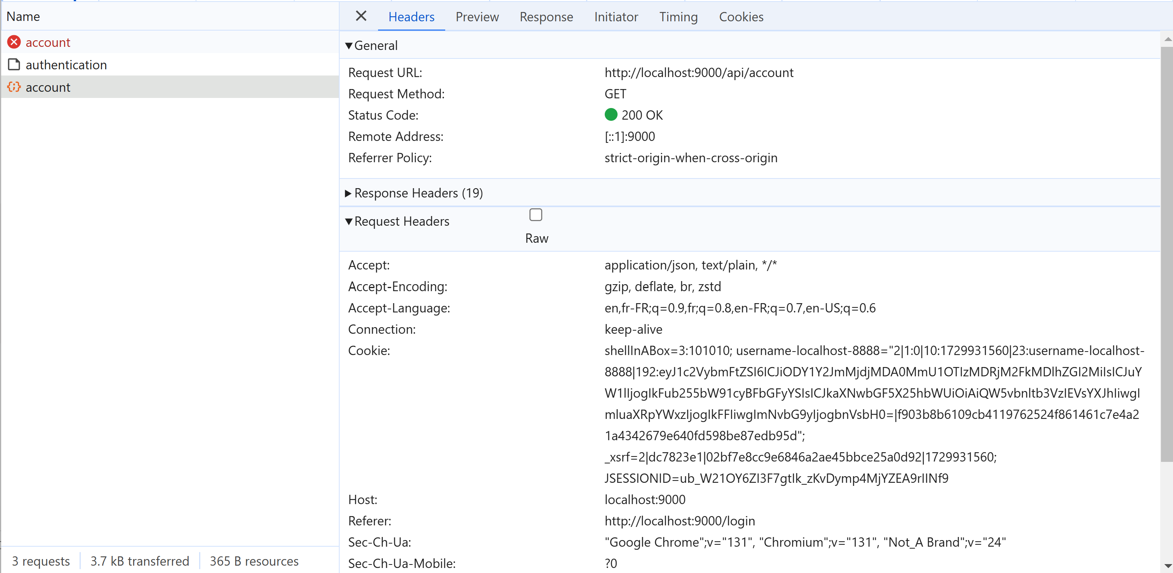
Request [3/3]: Http GET /api/account => status code: 200 OK

Slide 35
Difference between Failing Request [1/3] and Success Request [3/3] (Authenticated)

Slide 36
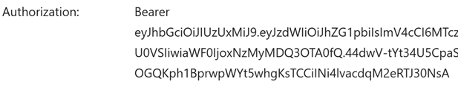
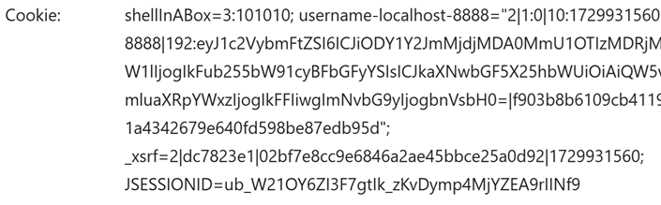
Difference Authentication with JWT Mode
"JWT" Mode
"Http Session" Mode
the JWT secret is passed via Http Header
"Autorization": "Bearer {token}"
the JSESSIONID secret is passed via Http Header
"Cookie" : "key=value; .... ; JSESSIONID={sessionid}"

Slide 37
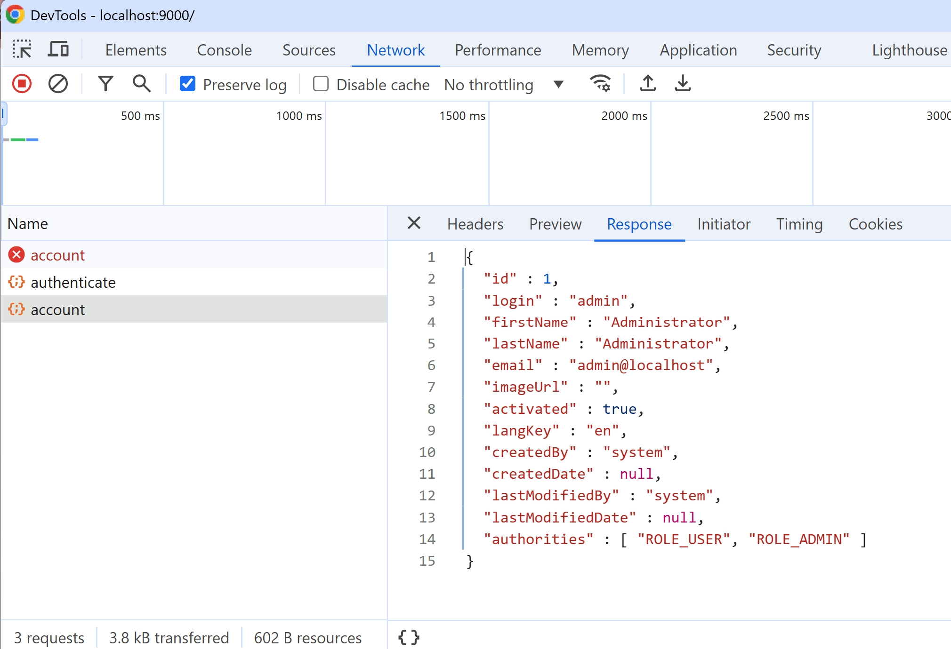
Request [3/3]: /api/account Response Body: Detailed Information on Account

Slide 38
NO Difference for Authorization with JWT Mode
"JWT" Mode
"Http Session" Mode
NO difference
in both cases, ROLE_* are retreived from Http GET "/api/account"
They were redundantly present in JWT Token, but not used

Slide 39
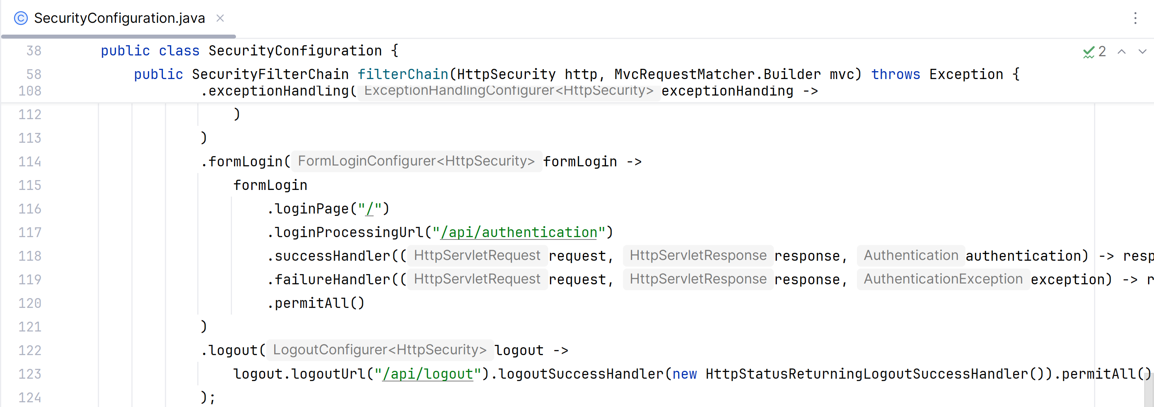
Backend Code for Http POST /api/authenticate ... framework code, rely on spring UserDetailService

Slide 40
Backend Code for Filter Request Authentication + JSESSIONID ...
???? This is NOT EVEN in spring framework
It is handled directly by the "Servlet" engine (Tomcat / Jetty / ..)

Slide 41
Difficulties for Load-Balancing on Many SErvers with COOKIE "JSESSIONID"
The "Http Session" mode with Cookie JSESSIONID is deprecated
It existed from long time ago, directly in Tomcat, and in servlet spec
It is NOT very efficient, and impose constraints on the way the servers save JSESSIONID
If you have only 1 server => OK, fine (JSESSIONID can be in-memory)
But if you have a load-balancer and many servers => how to share ?...

Slide 42
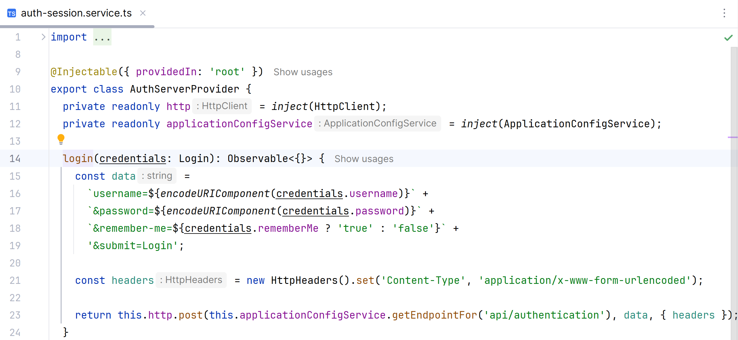
Angular Code for low-level Http POST /api/authenticate

Slide 43
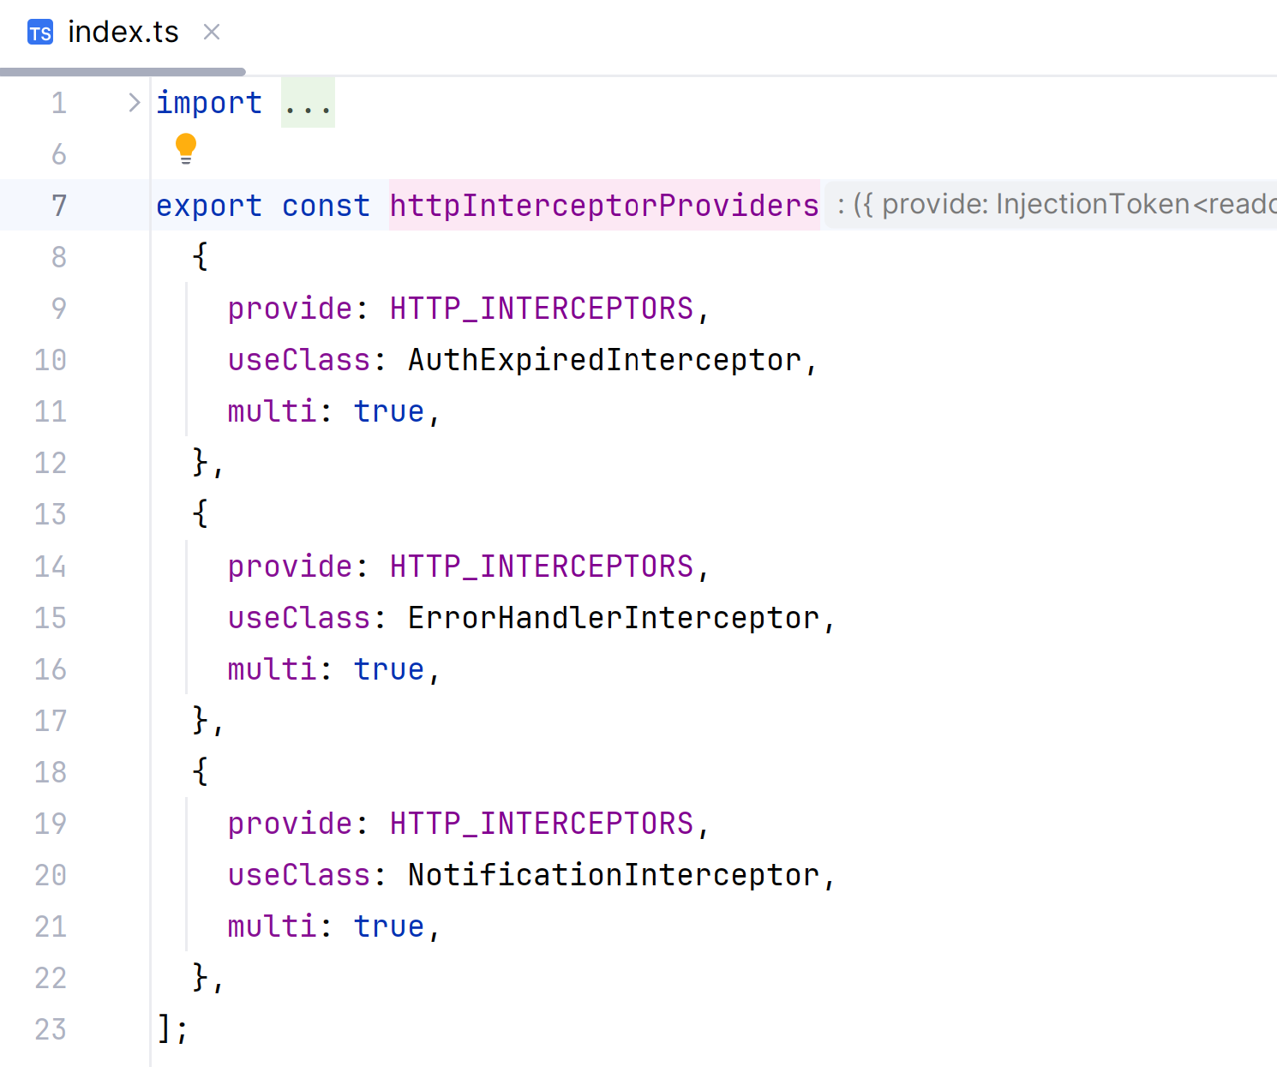
NO Need of Custom "HttpInterceptor" for transmitting the Cookie !

Slide 44
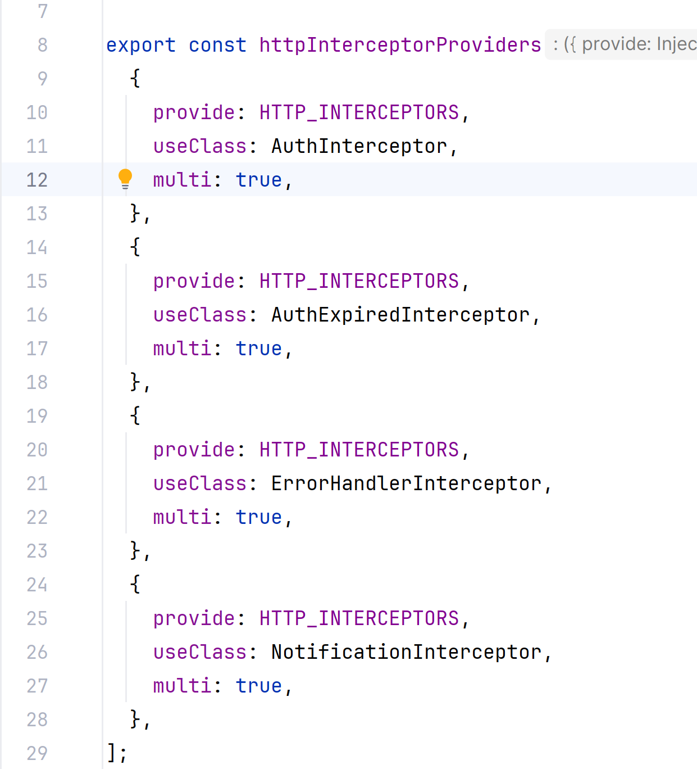
Difference HttpInterceptors with JWT
"JWT" Mode
"Http Session" Mode

Slide 45
Authorisations
For Authorization (ROLE_*)
there is NO difference with the others mode JWT or OAuth2.
Please see previous detailed document on JWT

Slide 46
Network & Infrastructure Deployments Options

Slide 47
Servers are Statefull - Need Centralised Database
LoadBalancer
to any Server
need centralised Database !!
performance Bottleneck
& SPOF = "Single Point Of Failure"
Statefull servers

Slide 48
Server Connected in Cluster "Distributed Cache" (=idem embedded database)
LoadBalancer
to any Server
NO "SPOF"
(Single Point Of Failure")
But very complex
Cluster of
Statefull servers

Slide 49
LoadBalancer with "Session Stickiness" Statefull Server (local DB or in-memory not persisted)
redispatch always
to same Server
as first Cookie request
Server are Statefull
If Cookie are only "IN-MEMORY"
=> server crash = losing cookies
LoadBalancer
with SessionStickiness

Slide 50
Next Steps
Previous document
1/3 : Debugging "JWT" security mode
This document
[2/3]: Debugging old-style COOKIE "jsessionId" security mode
Next document:
[3/3] Debugging the OAuth2 security mode

Slide 51
Questions
arnaud.nauwynck@gmail.com

